Slide 1
8086 System Configuration

Slide 2
8086 Minimum Mode Configuration
The microprocessor 8086 is operated in minimum mode by strapping its MN/MX pin to logic 1.
There is a single microprocessor in this mode.
All the control signals are given out by the microprocessor chip itself.
The remaining components in the system are:
      Clock Generator Intel 8284
      Bidirectional Bus Transceiver Intel 8286/8287
      8282 Address Latch (8282/8283)

Slide 3
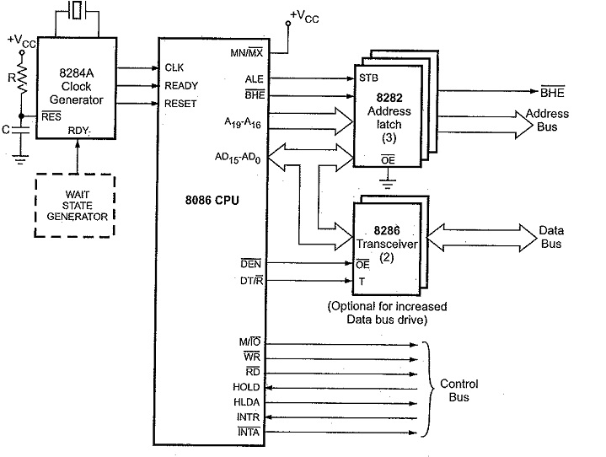

Slide 4
Pins in minimum mode
MN/MX’
It stands for Minimum/Maximum mode.
It indicates what mode the processor is to operate in; when it is high, it works in the minimum mode and vice-versa.
INTA’
It is an interrupt acknowledge pin.
Whenever an INTR signal is generated, then the microprocessor generates INTA signal, as a response to that interrupt.
INTA is low in two consecutive bus cycles.
The first pulse indicates interrupt acknowledgement and during second pulse, type of interrupt is shown on the data bus.
ALE
ALE is an abbreviation for address latch enable.
when pulse goes high means ALE=1, it makes address bus enable and when ALE=0, means low pulse makes data bus enable.
DEN’
DEN is used for data enable.
This is an active low pin that means whenever a 0 is present at this pin then the transceiver gets enabled and it separates the data from the multiplexed address and data bus.

Slide 5
DT/R’(Data Transmit/Receive) – Pin number 27
This pin is used to show whether the data is getting transmitted or is received.
A high signal at this pin provides the information regarding the transmission of data. While a low indicates reception of data.
M/IO’ – Pin number 28 –
This pin indicates whether the processor is performing an operation with memory or I/O devices.
Whenever a high is present at this pin then it shows the operation is carried out through the memory.
While a low signal shows operation through I/O devices.
WR’ – Pin number 29 –
An active low signal at this pin indicates that the processor is performing write operation from either memory or I/O devices.
HOLD – Pin number 31 –
When an external device enables this pin then the processor stops accessing the buses immediately after the recent task gets over.
HLDA – Pin number 30 –
This pin is used as a response pin for the hold request. Once request for accessing the buses is produced by an external entity. Then the microprocessor acknowledges the device that its request will be considered once it gets over by the current operation.

Slide 6
Clock Generator Intel 8284
To synchronize the internal and external operations of the microprocessor a clock (CLK) input signal is used. The CLK can be generated by the 8284 clock generator IC.
It is an 18-pin IC.
It provides CLK, READY and RESET signals to the 8086.
CLK provides basic timing for processing operation and bus control activity and is generated based on the frequency of crystal connected between X1 and X2.
RESET signal is used to terminate the present activity of the processor immediately.
READY
It is an active high signal. When it is high, it indicates that the device is ready to transfer data. When it is low, it indicates wait state.

Slide 7
8282 Address Latch
Latches are generally buffered output D-type flip-flops like 74LS373 or 8282.
They are used for separating the valid address from the multiplexed address/data signals and are controlled by the ALE signal generated by 8086.

Slide 8
8286 Transceiver
Transreceivers are the bidirectional buffers and some times they are called as data amplifiers.
They are required to separate the valid data from the time multiplexed address/data signals.
The ALE(Address Latch Enable) signal acts as strobe(a signal to validate) for latching
They are controlled by two signals namely, DEN’ and DT/R’.
The DEN signal indicates the direction of data, i.e. from or to the processor.
When DEN is 0, it indicates data are transferred to Transceiver.

Slide 9
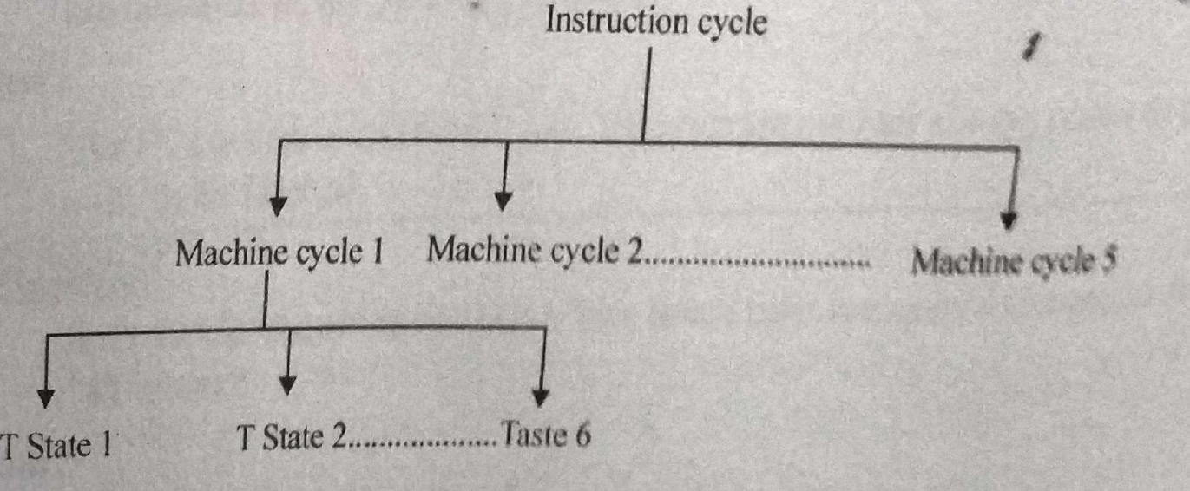
Timing Diagram
It is the graphical representation of the working each instruction and execution with respect to the time.
The timing diagram represents the clock cycle and duration, delay, content of address bus and data bus, type of operation.
Terms Related to the Timing Diagram
Instruction Cycle:
The number of steps required by the cpu to execute an instruction.
Machine Cycle:
It is the time required by the microprocessor to complete the operation of accessing the memory or I/O devices.
In machine cycles, the operations like opcode fetch,memory read, memory write, I/O read, I/O write are performed.
T-state: Each clock cycle is called as T-state
Instruction Cycle=Fetch Cycle + Execute Cycle

Slide 10
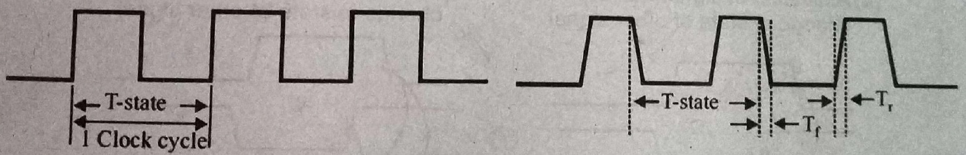
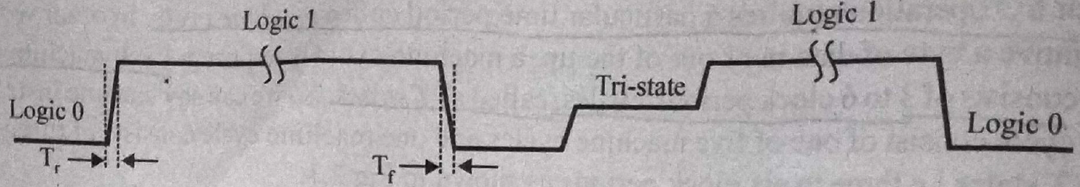
Representation of signals
Clock Signal
All the operations in the microprocessor are synchronized with the operating frequency.
Ideally the clock signals should be square wave with zero rise time and fall time but in practice, the signals are always with finite rise and fall time.
Single Signal line
Single signal line is represented by a line.
It can have the status either logic 0 or logic 1 or tristate.

Slide 11
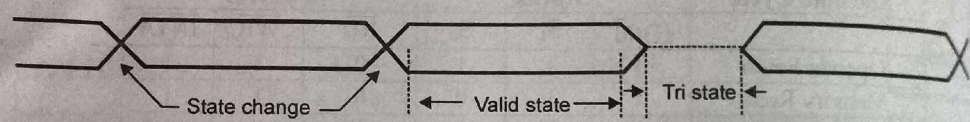
Group of Signals
Group of signals is also called a bus.
In the timing diagram, these signals are grouped and shown in the form of block.
Change in the state of single signal changes the state of the group and it is represented by the cross.
The tristate condition of the group signal is shown by dotted lines.
Two straight lines represent valid state/stable state.

Slide 12
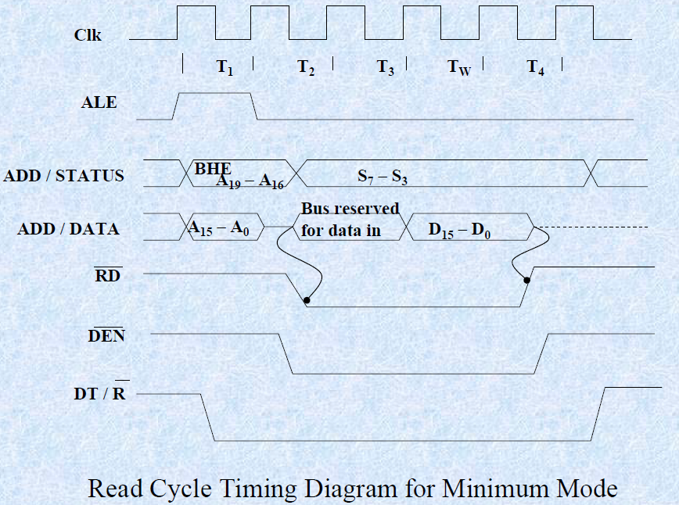
Read Cycle Timing Diagram of Min Mode

Slide 13
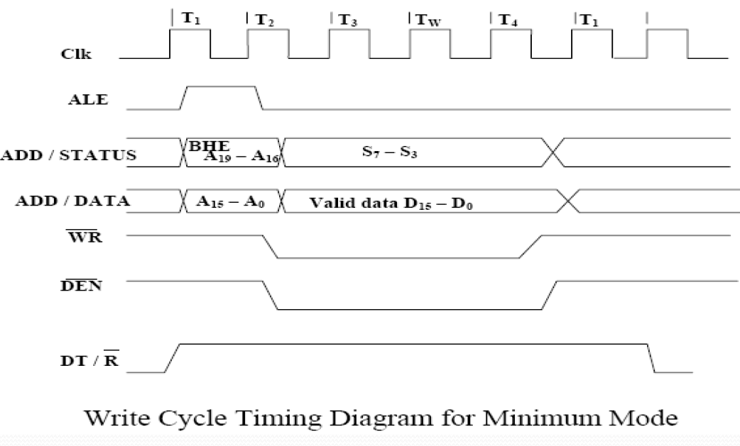
Write Cycle Timing Diagram of Min Mode

Slide 14
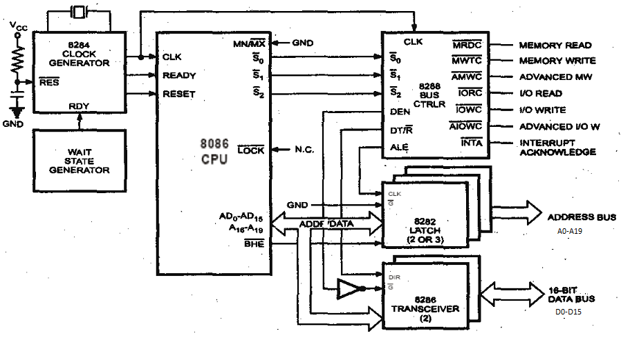
Max Mode of 8086

Slide 15
In the maximum mode, the 8086 is operated by strapping the MN/MX* pin to 0.
This mode works for Multiprocessor system.
Microprocessor does not directly provide all control signals.
Intel 8288 bus controller is used to implement the control circuitry.
Prior to operation, three status signals s2,s1,s0 are produced, which identify the type of bus cycle.
bus controller derives the control signals using this status information.

Slide 16
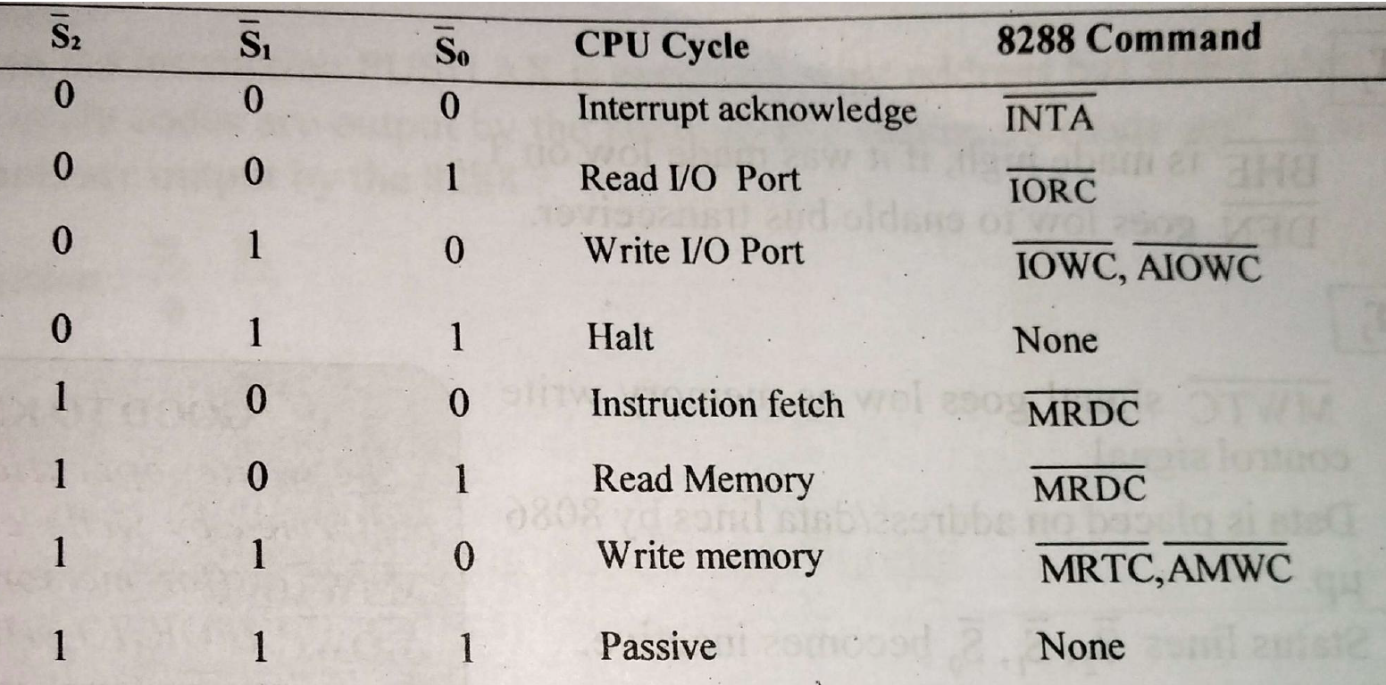
Bus Controller
The bus controller chip has input lines S2*, S1* and S0* and CLK.
These inputs to 8288 are driven by the CPU.
The values of status signals are decoded by the bus controller and generates INTA’, MRDC’, MWTC’,IORC’,IOWC’,AMWC’ and AIOWC’.
These signals are used to interfacing 8086 to memory and I/O devices.
ALE,DT/R’,DEN’ are also generated by 8288 bus controller.

Slide 17
AEN’:The address enable input causes the 8288 to enable the memory control signals.
CEN :The control enable input enables the command output pins on the 8288.
IOB :The I/O bus mode input selects either I/O
bus mode or system bus mode operation.

Slide 18
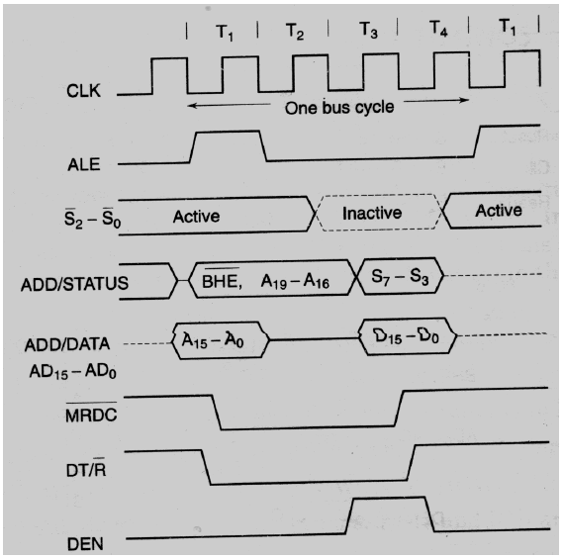
Max mode Read Cycle

Slide 19
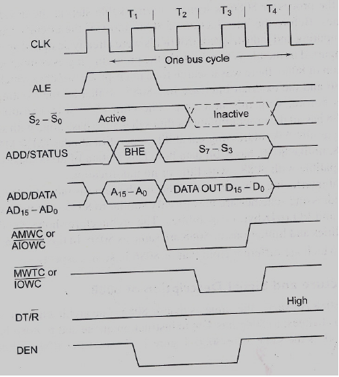
Max mode Write Cycle

